Slide 1
Neural networks for speech separation
Qingzhuo Zhang
Supervised by Dr Thomas Blumensath

Slide 2
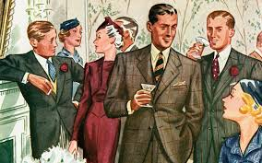
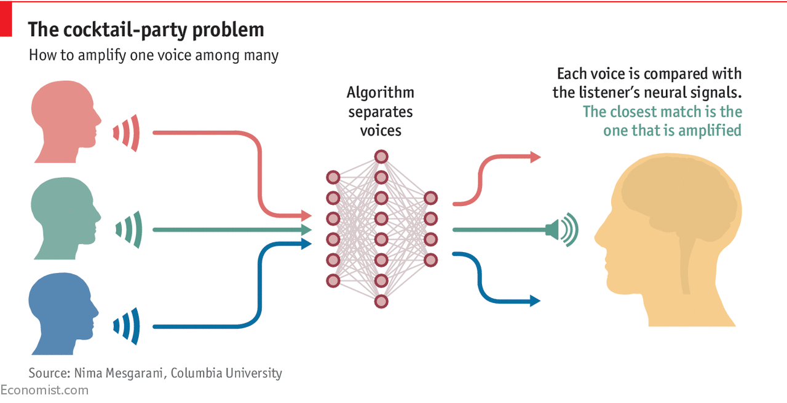
What is speech separation? and application?

Slide 3
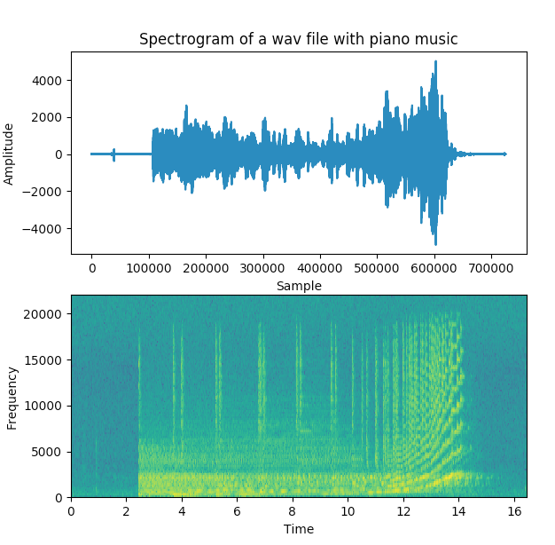
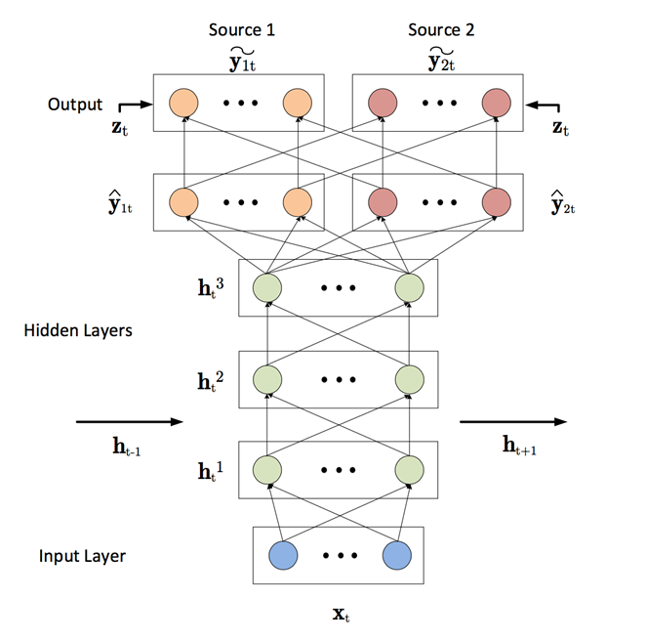
How to achieve?

Slide 4
When?

Slide 5
Thanks for your listening!

